Slide 1
Module Summary 131-135
Advanced Compiler Techniques
Source: https://www.youtube.com/playlist?list=PLf3ZkSCyj1tf3rPAkOKY5hUzDrDoekAc7
Videos: 131 - 135

Slide 2
Summarizing
Changing axes using Fourier Motzkin method (131)
Affine array accesses (132)
Data Reuse (133)
Data Reuse Category: Self Reuse (134)
Data Reuse Category: Self Spatial Reuse (135)

Slide 3
Module 131: Changing axes using Fourier Motzkin Method

Slide 4
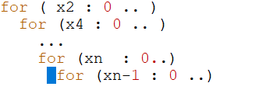
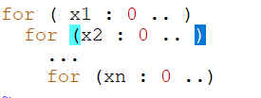
Changing axes/order of loop iteration indices
Fourier Motzkin: To project a polyhedron on a smaller dimension
For n-Dimension poly -> Remove n^{th} Dimension & project Poly on remaining n-1 Dimensions
Manipulate inequalities that represent polyhedron.
Problem: Given polyhedron iteration space S, generate a loop nest with new order (x₁, x₂… ,x_{n}) of loop iteration indices.
Change indices order: Respect data dependencies
For the new order: What is LB and UB for each of iteration indices ?
Fourier Motzkin
Notes:
Polyhedron representation S = { x | Bx + b >= 0 } . x is a vector of loop iterations.
FMM: For every pair of LB and UB on xm in C such that (inequation form) L <= c1 * xm and c2 * xm <= U , for c1, c2 >=0
Data dependency : Assume no data dependency or after reordering data dependencies are respected.

Slide 5
Loop Bounds Generation for loop iterations indices
Algorithm
Start with innermost loop index x_{n}
Bring inequations to form: (for c₁, c₂ >= 0)
L <= c1 * x_{n}
c₂ * x_{n} <= U
Use Fourier Motzkin recursively to project on remaining indices x₁, x₂,.. X_{n-1}
Output: Upper and Lower bound for x₁, which is constant.
Use above inequations to get lower upper bound of x₂, … till x_{n}
Notes:
After removing xn, you will get S’. Do it recursively on S’ to project on n-1 indices and so on.
Ouput: LB/UB of x2 in terms of x1. Use xn >= L/c1 and xn <= U/c2 . L and U are affine expression on x1, x2.. xn-1

Slide 6
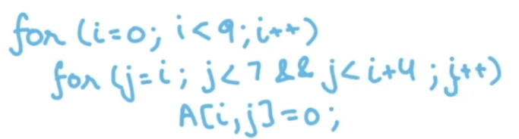

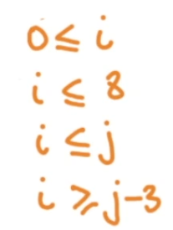
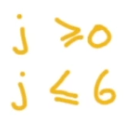
Loop Bounds Generation
Desired order: j[outermost], i[innermost]
Start with inner-most loop index i.
Bring inequations to expected form
Remove i and project S on remaining indices i.e. j
Once projected: use inequation to identify UB & LB of inner index i.e. i (based on fixed value of outer index)
Notes:
Desired order: j, i
Start with inner-most loop index i. Remove i and project S on remaining indices i.e. j

Slide 7
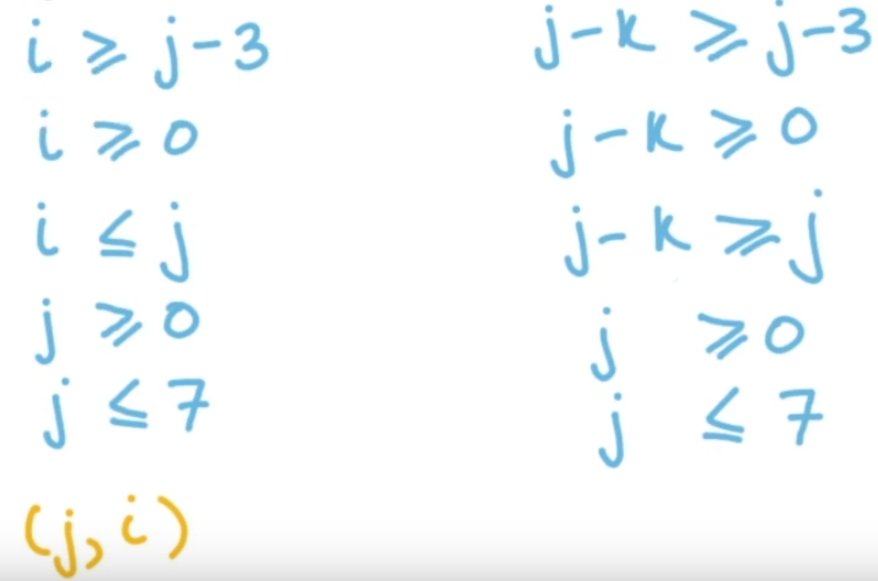
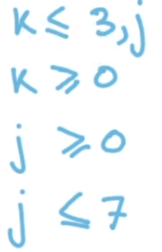
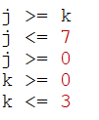

Changing Axes
Can iterate horizontally, vertically and diagonally (j-i, j).
LB and UB on new axes: new variable k = j-i . Desired order (k [inner index], j [outer index])
Use same algo to find LB and UB for k and j, which uses Fourier Motzkin algo
Traverse order : (k [outermost] , j [innermost]])
Project on k, eliminate j
Get LB/UB of outer loop on k
Notes:
Should cover same entire space, in whichever direction traverse.
Replace i with j-k in inequations

Slide 8
Module 132: Affine array Accesses

Slide 9
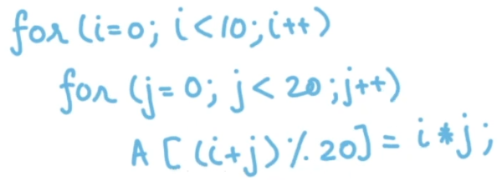
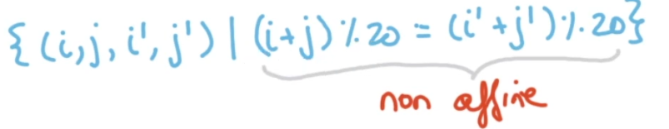
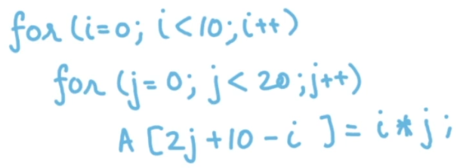

Data Dependencies
Reordered iteration indices: Switching order of iteration space, Changing axes
Memory access within each iteration & Data Dependencies as result of changing axes
Do 2 iterations access same memory location ? Data Dependent. No reordering.
Pair: Iteration 1: (i, j), Iteration 2: (i’, j’)
2nd part: Constraint for memory access
Affine constraint, affine expression (C_{i}x_{i} + C₀)
Not affine : % is not covered by affine expression
Notes:
Which iterations are data dependent? . Condition for data dep: Read/write of 1 iteration depend on read/write of other iteration
Ci xi + C0 .. Xi is variable on which the expression is affine. Ci and C0 are constants.

Slide 10
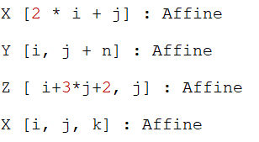

Affine array Accesses
Most programs have affine access to memory w.r.t. surrounding loop indices
Array access in loop is affine, iff
Loop bounds are expressible as affine expressions of
Surrounding loop indices & symbolic constants (regular constants, loop invariant)
Index for each dimension of array (1D- A[i] or 2D- A[i,j]) access, is also affine expression on
Surrounding loop indices & symbolic constants.
Example: 2j+10-i: Affine expression. i+j %20: Not affine expression
Examples: Indices i, j, k have affine bounds, n is loop invariant.
Not affine: Multiply with symbolic constant (which is not regular constant
Affine: Addition to symbolic constant
Notes:
1. i & j surrounding indices & have bounds. 1D array. 2. 2d. N is loop invariant.
NOt Affine: Multiplying with symbolic constant which is invariant . But want actual constant. Addition to symbolic constant

Slide 11

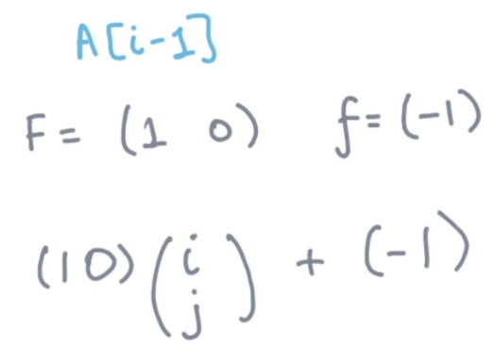
Affine array Accesses
Representation for 1 Array access in a loop nest: 4 tuple < F, f, B, b>
B and b : Represent space of iteration space of polyhedron
F and f : Represent affine expression w.r.t loop iteration indices which specify multi-dimension address of memory access
If loop nest uses: a vector of index variable i, then Bi + b >= 0 [ Iteration space]
Accessed array element : Fi + f [ Memory address]
F : Coefficient matrix: represents coefficient of each of loop indices (CiXi + C0). F-Ci, f-C0
Example: Surrounding loop iteration indices vector
Examples:
2D access B[i, j] , Y[j, j+1] , Y[1,2]
3D access: Z[1, i, 2* i+j]
Notes:
-Iteration space: Based on LB and UB can define a region/polygon which will be traversed by this. Area traversed by iterations and represented by polyhedron.

Slide 12
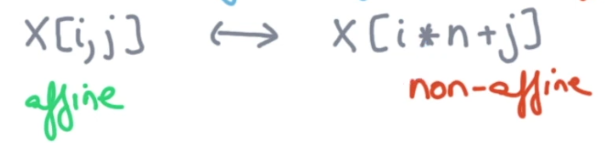
Affine array Accesses
Linearized forms for multi-dimensional arrays : may be non-affine
For polyhyderal analysis: prefer non-linearized affine representation
Common in image processing and neural networks
Easier to analyze and optimize
Affine array access
Used to reason about data dependencies and resue characteristics.

Slide 13
Module 133: Data Reuse

Slide 14
Data reuse
Reason about memory access. To identify memory footprint of each access
Find if 2 iterations are related, like if data dependency between them.
Data reuse property: Identify sets of iteration that access same data or same cache line.
Can optimize for locality. Can bring those iteration close in execution time.
Useful for locality optimizations
Data dependence property
Identify access that refer to same memory location & at least one of them is a write.
For given 2 accesses: RAW, WAR, WAW.
Don't reorder iterations when these exist, as it will give different results.

Slide 15
Data reuse categories
Self reuse
Multiple iterations of same statement access same data
Group reuse
Two same iterations of different statements access same data
If different statements access same data in same iteration
Data Reuse (Temporal) is
Temporal:
If exact same data is accessed multiple times across iterations.
Useful in cacheline or general locality.
Spatial:
If different data in same cacheline is accessed.
Useful in cacheline locality only.

Slide 16
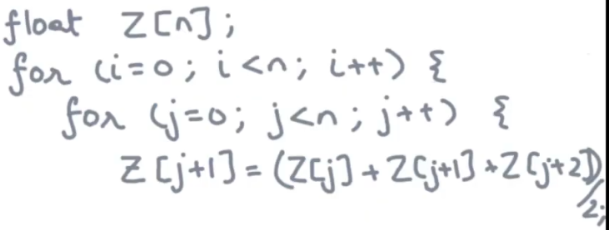
Data Reuse
Self Spatial reuse
Each of Z[j], Z[j+1], Z[j+2] have self spatial reuse across different iterations.
In isolation, Z[j] has self spatial reuse in different iterations. High spatial locality.
4 Different accesses considered as separate statements.
Z[j] likely to hit in same cache line
Self Temporal reuse
Exact same element is accessed repeatedly once for each iteration of outer loop.
Group spatial reuse
Z[j], Z[j+1] access same cache line
Group temporal reuse
Across different iterations. Access by Z[j] would be accessed by Z[j+1] in next iteration.

Slide 17
Data Reuse
No. of memory access = 4n² . For each iteration n² access. 4 accesses for each.
Memory footprint = n/c cache lines . c = cache line size. Distinct memory location order n.
From 1 & 2. Pigeon-hole principle . Data reuse.
Reuse factors
Factor of n: Due to self temporal reuse. 4n² & n/c.
Factor of c: due to self spatial reuse. Cache line access by same statement.
Factor of 4: due to group temporal reuse.

Slide 18
Module 134: Self Reuse (Temporal)

Slide 19
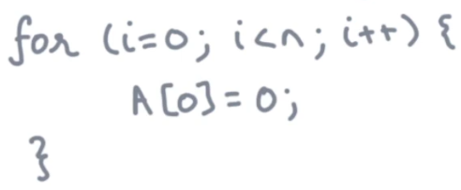
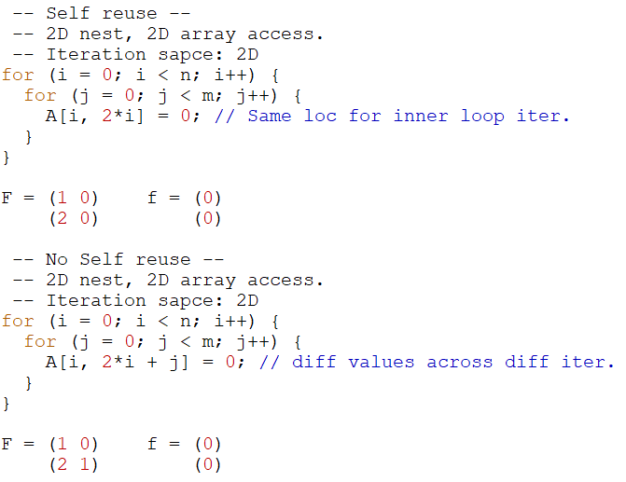
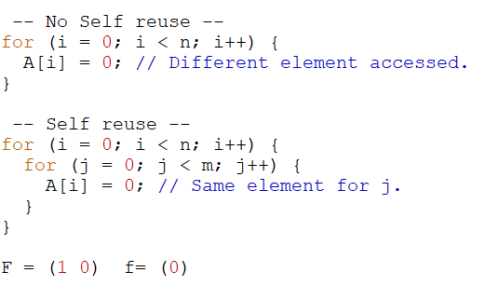
Self Reuse (Temporal)
Self reuse: Same element accessed for all iterations. F=(0), f=(0)
Find relation between: F, f and reuse

Slide 20
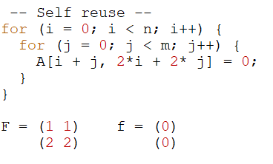
Self Reuse (Temporal)
Self reuse reason:
For A(10, 20)
Order n indices: (0,10), (1,9)...
Multiple points in iteration space access same array location
If data referenced by access has
k dimensions: Dimensionality of access. Example: A[i+j, 2i+2j] 1D space.
Access is nested in d-depth loop nest, where d > k, (loop nest depth=2, dim of access= 1)
Then same data can be reused : n^{d-k} times

Slide 21
Self Reuse (Temporal)
Dimensionality of a reference ~ Rank of the coefficient matrix (F)
Self Reuse: Rank of coefficient matrix < dimensionality of loop iteration space
k < d : Reuse.
k !< d : No reuse.
Find self reuse or not
Identify to find iterations i and i’ (number of points in i and i’) where
Fi + f = Fi’ + f . Or F(i - i’) = 0
If F is full rank matrix.
Only 1 trivial solution: i = i’ . (same iteration and thus reuse). No non-trivial solution.
If F is not full rank matrix (rank of F < total dimension of matrix).
Other non-zero solution: Null space of F.
Notes:
Rank of matrix: No. of linearly independent row & columns of matrix. F (1 0 , 0 1) -> can’t find 2nd row using 1st. Rank = 2.

Slide 22
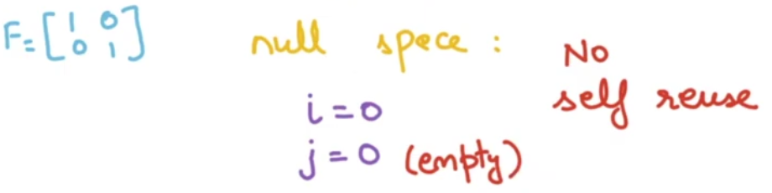
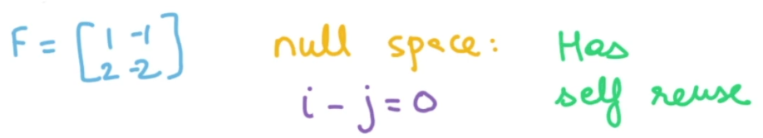
Self Reuse (Temporal)
Full rank matrix. Dim of matrix = 2x2 and Rank of matrix= 2
Rank of matrix = 1. Null space (non-empty): i =j. FX = 0 . Points of order n.
Notes:
Rank of matrix: No. of linearly independent row & columns of matrix. F (1 0 , 0 1) -> can’t find 2nd row using 1st. Rank = 2.

Slide 23
Module 135: Self Spatial Reuse

Slide 24
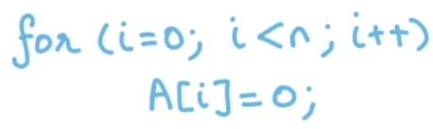

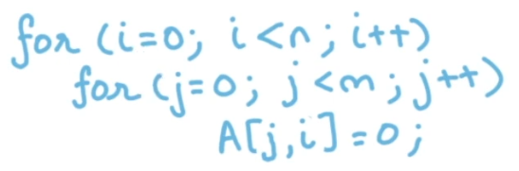
Self Spatial Reuse
Self spatial reuse: Different elements accessed in each iteration.
Self reuse, temporal: No. Same element not accessed in different iterations. F=(1). R=1, Dim=1.
Self spatial reuse: Yes. A[0] in cache. A[1].. will hit same cache.
Self reuse, temporal: No. Rank=2. Dim=2.
Self spatial reuse: Yes.
If cache lines are accessed multiple times across different points in iteration space
Access (1,0) and (1, 1) are adjacent elements
Reuse distance for spatial locality large but spatial reuse.
Notes:
Dim != Rank. So no reuse.
Access (1,0) and (1, 1) are adjacent elements

Slide 25
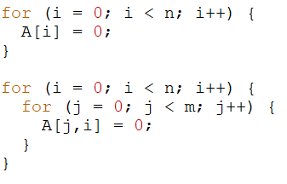
Self Spatial Reuse
To reason Self spatial reuse, need to know Size of cache line.
Approximation: Consider 2 array elements access. They share same cacheline iff
They differ only in last dimension of a d-dimension array.
Assuming: all elements in last dimension fit in a single cache line.
For last dimension, accesses are cheaper, so approximation meaningful.
Last dimension: i. Belongs to 1 cache line. i removed, 0 dim access.
Remove i^{th} index. j fits in 1 cache line.
Dimensionality of access = 1 (j index)
Dimensionality of loop nest = 2
1 < 2. So self spatial reuse.
Notes:
Dim != Rank. So no reuse.
Access (1,0) and (1, 1) are adjacent elements
Crude assumption: entire dimension fits in cache line. But n is large. Cache line size = 64 byes.
For last access, once every c accesses. S 1/c probability -> cach emiss.

Slide 26
Self Spatial Reuse
For self spatial reuse:
Truncate F by removing / Drop last row of coefficient matrix F. (New step in self spatial reuse)
Resulting coeff matrix is effective coefficient matrix.
If Rank of truncated matrix < depth of loop nest then self-spatial reuse.
Significance of identifying self spatial reuse
It may be possible to reorder computation such that (we exploit spatial locality)
Innermost loop varies only the last coordinate of array
If self spatial reuse: Is it possible to reorder computation such that
Reuse distance between multiple accesses to same cacheline becomes close in exec order
Notes:
Spatial Locality: Stronger. There is reuse and reuse distance is small.
If no self reuse, no spatial locality.
-Reuse distance: Distance between 2 uses of same location.

Slide 27
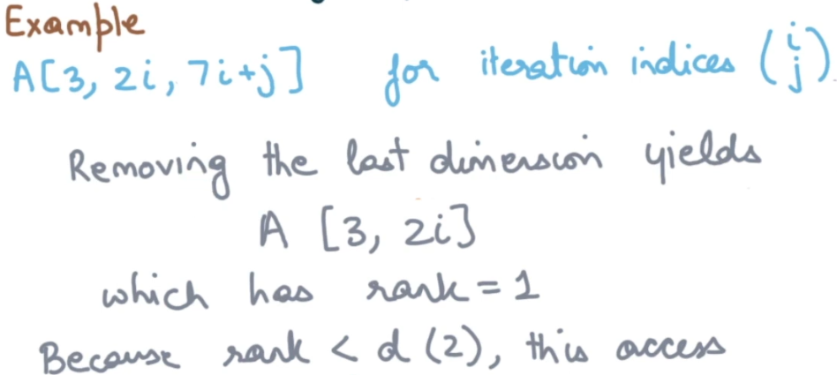
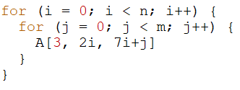

Self Spatial Reuse and Spatial locality
Innermost loop index: i.
Innermost loop index: j .
Apart from self spatial reuse. Will also exhibit spatial locality. (innermost loop iterates on innermost dimension and it is in cache line.)
Iteration vector should belong to nullspace of truncated F to obtain spatial locality
Null space should be non-trivial. Need more points than 0.
Has Self spatial reuse. Not spatial locality
Iteration vector
Notes:
Spatial Locality: Stronger. There is reuse and reuse distance is small.
If no self reuse, no spatial locality.

Slide 28



Self Spatial Reuse and Spatial locality
Innermost loop index: i. A [3, 2i, 7i + j]
Doesn’t satisfy the requirement
If use (i, j). j inner. In null space. Has spatial locality. Reuse
If use (j, i). i inner. Not in null space. No spatial locality. Reuse
For locality order of iteration space matters, if i inner or j. Not for reuse.
A[3, 2i, i+7j] . Remove i+7j. For A[3, 2i], Rank=1. Spatial Reuse.
A[2i, i+7j, 3] . Remove 3. For A[2i, i+7j]. Rank=2. Dimensionality=2. No spatial reuse.
A[j, j, i] . Rank =1 < 2. Has spatial reuse. If i innermost, would have spatial locality.
Notes:
Spatial Locality: Stronger. There is reuse and reuse distance is small.
If no self reuse, no spatial locality.

Slide 29
Thank you
Pankaj Gode

